Slide 1
Design Thinking in IT

Slide 2
Contents to be covered
Design thinking in IT industries
Design thinking to Business Process Model
Design thinking for Agile Software Development
Virtual Collaboration
Scenario Based Prototyping

Slide 3






Design thinking in IT industry
Understanding IT industry with an example
XYZ InfoTech
promises to use technology to solve all of your problems!
IT companies - They build software to make other businesses run smoothly!
Now if I know some technology and ask a programmer to solve problems by building specific pieces of software
IT companies build or maintain software so that businesses run more smoothly. Anyone who builds or maintains software belongs to the IT sector.
My grocery company has got IT department

Slide 4
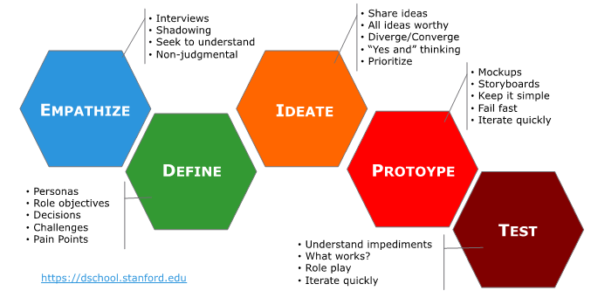
Design thinking in IT industry
Design Thinking in General

Slide 5
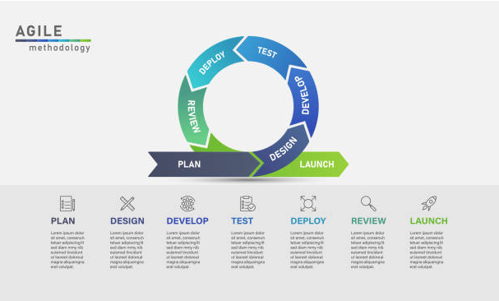

Design thinking in IT industry
Project management
IT Industry

Slide 6
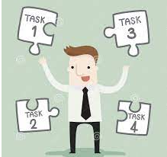
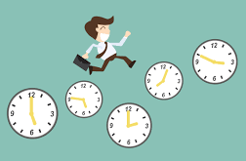
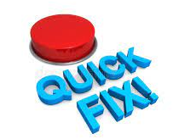
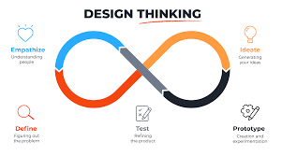
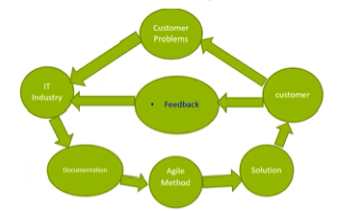
Design thinking in IT industry

Slide 7
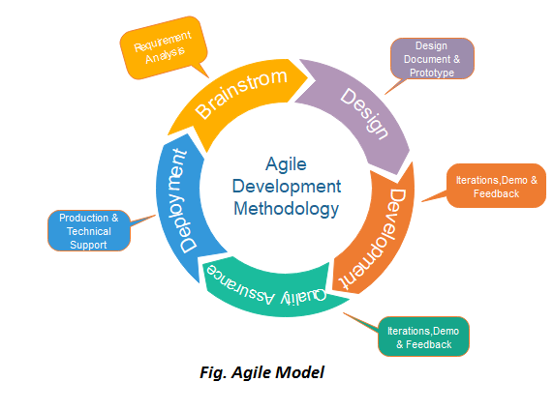
Design thinking in IT industry
Agile model of Project Management

Slide 8
Design thinking in IT industry
Design thinking and Agile methodology
30-35% or even 50% of the IT projects fail according to research
Agile improves success rate by almost double by promoting better collaboration and communication
But Agile only provides way to solve problems and how can 1 decide which is the right problem to solve
This is where Design thinking plays a vital role
Combining both is not an easy task and requires culture shift (new way of thinking and doing) and one has to get accustomed to this cultural shift
This combination value people over processes
Organizations have to allocate right people for the projects and they should ensure cultural compatibility between teams and the way Design thinking and Agile methodology work

Slide 9
Design thinking in IT industry
Best practices for combining Design thinking and Agile methodology
Invest in user research
A clearly defined problem statement
Build a productive team culture
Optimal use of Design thinking
Design patterns and periodic testing

Slide 10
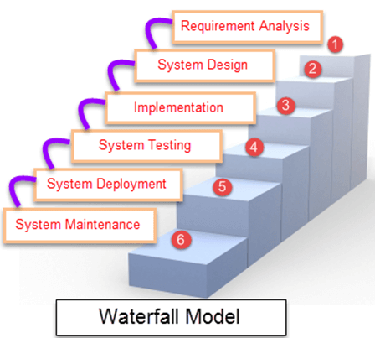
Design thinking in IT industry
Waterfall Model

Slide 11
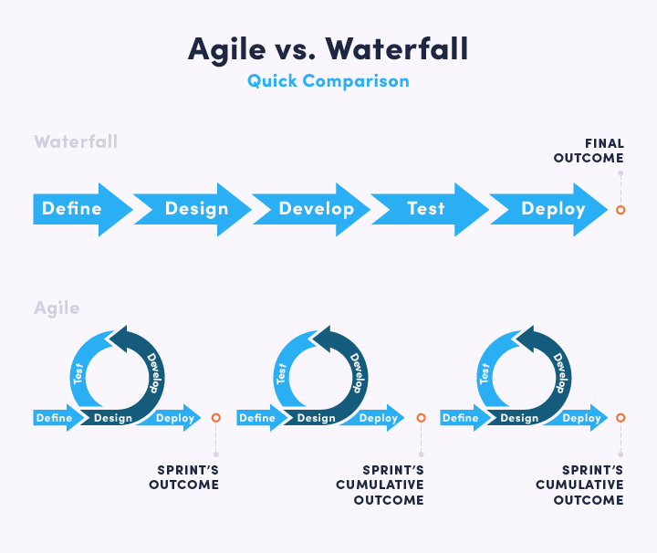
Design thinking in IT industry

Slide 12
Design thinking in IT industry
Agile is an iterative and incremental method of managing development and design
Test
Configure
Release
Build
Design

Slide 13
Design thinking in IT industry
Advantages of Agile Development Method used in software development in IT Industry
Solutions are Prototyped and Results are verified
Best solutions are accepted
Before approval itself the solutions are experienced by the client
To improve user experience short iterations are possible
Small cross-functional teams
Incremental delivery is possible
Fast feedback helps the designers and developers
Continuous improvement is possible

Slide 14
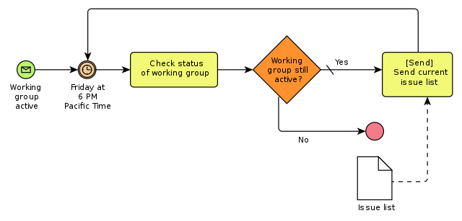
Design thinking in IT industry
Design thinking in Business Process Modelling
What is Business Process Model?
Business process management (BPM) is a way of breaking down business processes into their most basic elements: the tasks and activities a business carries out. BPM shows, clearly and transparently, how a product or service transforms as it moves through an organization's process sequence, often in near real-time.

Slide 15
Design thinking in IT industry
Design thinking in Business Process Modelling
Process models mediate communication between stakeholders: Business analysts, process participants and software architects
Process models provides shared understanding so that everyone can contribute knowledge
BPM – Combination of various process related steps: Process mapping, Process discovery, Process simulation, Process analysis and Process improvement.
BPM – Arrived from last few decades and have replaced previous organizational efficiency packages: Time and Motion Study (TMS) and Total Quality Management (TQM).
Process models mediate communication between stakeholders: Business analysts, process participants and software architects

Slide 16
Design thinking in IT industry
Design thinking in Business Process Modelling
Advantages of BPM
Align operations with business strategy
Improves process communication
Increase control and consistency
Improve operational efficiencies
Gain competitive advantage

Slide 17
Design thinking in IT industry
Design thinking in Business Process Modelling
By revealing the way things are done at an organization, and comparing that with the way things should be done, BPM highlights the dependencies and relationships between people, process, and technology—and where those elements are ripe for improvement.
Design thinking is also focused on improvement, but takes the end-user or customer experience as a starting point. Fundamentally, design thinking uses empathy to understand the way people feel about using a service or product, including where their frustrations lie, then builds on that knowledge to create improvements, with the ultimate goal of making customers’ lives and experiences better and more fulfilling.

Slide 18
Design thinking in IT industry
Design thinking in Business Process Modelling
The similarities to BPM are clear. Process improvement requires the same approach of identifying a challenge (like an inefficient process), generating the information needed to understand why the process is inefficient, implementing a possible solution, then measuring the effectiveness of that solution over time. Rinse and repeat! Merging the two disciplines essentially means using the insights gained through an effective BPM framework to feed into the design thinking process, and enhance customer-facing business processes.
There are five key phases of design thinking:
There is a challenge: How do I solve it?
I have learned something: How do I act upon it?
There is an opportunity: What do I create?
There is an idea: How do I build upon it?
I tried something: How do I evolve it?
This is an ongoing, cyclical approach, with the practice of ‘design, test, and iterate’ at its center— that is, constantly creating and rapidly deploying prototypes or new ideas, then testing and reflecting on them, including through fast feedback from customers. Organizations therefore spend less time and resources any one idea, and yet have the capacity to quickly scale up any idea that has merit, and positive reactions from customers.
After all, without a clear view of the current state operational structure and business process landscape to analyze, the risk of producing a ‘solution’ which is in fact not fit for purpose, or causes issues in other parts of the system, is amplified.

Slide 19
Design thinking in IT industry
Design thinking in Business Process Modelling
Benefits of Design Thinking and BPM
Working in tandem, design thinking and BPM unlock a range of powerful (and potentially lucrative) benefits, including:
Competitive advantage, gained through a willingness to innovate, then ‘double-down’ on ideas that work, and discard ones that don’t—before they become a liability
Moving beyond traditional process maps and case models to more customer-centric and human-scale products and services
Pooling collective ease and enhancing collaboration, through building multidisciplinary teams to focus on a single problem
Harnessing natural empathy, leading to a better understanding of the needs and challenges of customers
Generating more revenue by ensuring a deeper level of customer satisfaction

Slide 20
Design thinking in IT industry
Agile in Virtual Collaboration
In the book ‘The Flat World’ The author Thomas Friedman indicates the word ‘FLAT’ with an imaginary impression that, technology and internet has changed the world so abundantly that in modern times people work remotely not only from a single geographic location but also across continents with different time zones, cultures and even languages.
Thomas Friedman explains flattening as (The world is flat, 2005) the combination of a personal computer with fiber optic micro cable, using the internet with the help of a working software.
Working remote and in a global environment is not so uncommon anymore and has gained acceptance as a general working norm in last couple of decades.
With insourcing, outsourcing and companies operating in a global environment do business globally. With the management headquartered at a single location however do operate with other regions with the use of technology. This means business run globally and hence projects within the organizations also path globally.
Agile methods are more popular in the software industry however have gain so much admiration that other industries also want to pursue its benefits in their businesses. Operating in a global environment make these frameworks more challenging to operate efficiently.

Slide 21
Design thinking in IT industry
Agile in Virtual Collaboration
Agile methodology can accept changes anytime compared to that of a waterfall method, and hence collaboration between collocated teams eases out the agile processes. Besides coordination; interaction, development, planning, review, retrospective sessions etc. also immensely reduce time and effort.
Working remote or distributed is considered being competitive and is considered a fit operating model. Some companies also provide it as a choice to its employees. Businesses want to leverage talent round the clock, use the best talent which may not be locally available, cheap labor by outsourcing to low cost countries, higher productivity and numerous strategic reasons.
With growing needs of working remote, it is intolerable to voice that agile methods will not work by distributed teams. Although few trials will arise, with the help of tools and techniques moving to a remote working environment is possible.

Slide 22
Design thinking in IT industry
Agile in Virtual Collaboration
Azhar Khwaja, PMP, Ph.D. Scholar | PMP® | PSM® | MSP® | ASM® | ITIL Expert
Agile Project Management with Virtual Teams
Published on July 9, 2020
The author undertook a major project with his organization and has implemented an agile management methodology with team members located in 4 countries.
The author of this paper undertook a major project with his organization and has implemented an agile management methodology with team members located in 4 countries.
Vital essentials to be contemplate for effectively management of distributed team members.

Slide 23
Design thinking in IT industry
Agile in Virtual Collaboration
ALLOW TRANSPARENCY
As company or a lead establish a transparent environment. Provide a sense of trust in the team members with the decisions they make an organize sessions with them to align these decisions with company goals and vision. Do not keep responsibilities a secret. Be clear over job functions. Make sure the outcomes are public across the team. Gather feedback. Establish open communication channels.
ESTABLISH A CULTURE OF CONTINUOUS IMPROVEMENT
Drive improvements within the team. Recognize potential improvement opportunities and obtain ideas from the team. Listen to suggestions and rationally take appropriate steps. Agile principle drives continuous improvement and thus team members are open for improvement opportunities. Generate calculated experiments to implement improvement initiatives.

Slide 24
Design thinking in IT industry
Agile in Virtual Collaboration
COMMUNICATION
Communication is perhaps the most important artefact in any team. how you structure your communication will determine the output. Practice deep communication at all levels. A strong emphasis on communication is the key. Communication need not happen only via emails, phone calls or meetings, however in enterprises major communication happen with the help or ERP tools which help you be agile all the time.
CONSTRUCTION OF A RHYTHM
There are three things which are absolute necessary in agile methodology: Transparency, inspection, and adaptation. Scrum also calls it the three pillars of Scrum (Scrum Guide, 2005). It is important we create a tempo which operates around these pillars of Scrum. Having said that this drives in creating a self-collaborating team which is a prime eminence of Agile.

Slide 25
Design thinking in IT industry
Agile in Virtual Collaboration
GENERATE A CULTURE OF COURAGE & FLEXIBILITY
This also goes with the concept of fail fast. Failure is not bad; it is okay to fail. However, here the key argument is to fail fast. Establish an environment where the team is courageous to take steps to try out something new. The idea is to reduce the delay. Detect the failure fast and further twist your initiatives.
ESTABLISH A SUSTAINABLE ENVIRONMENT AND WORK LIFE BALANCE
Often distributed team end up stretching their normal working hours which lead t over working than regular hours or working at odd time. Establish rules and ensure no team member is defaulting these principles making the fellow counterpart abuse this principle. Plan appropriate and set expectations accordingly.
VISUALIZE EVERYTHING
A very important footstep. Planning of tasks is easier leverage tools that provide you a visual interpretation of tasks to be completed. Establish a solution that allows the team members to view workflows, depict who is working on what, align together be able to pick the right task of right priority and at a right time. This solution will help you capture the right problem areas and effectively retrospect them to improve your processes.

Slide 26
Design thinking in IT industry
Agile in Virtual Collaboration
The best example being the COVID-19 Pandemic which taught employers to be agile and Employers offered flexible time options to employees. We can take the examples of our own institutions.

Slide 27
Design thinking in IT industry
Scenario based prototyping
Design thinking is at its best if tangible prototypes can be used to envision new products and services.
However, for complex software systems with multiple users usually such tangible prototypes are not feasible.
To overcome this problem, scenario-based prototyping approach can be proposed for designing complex software systems that is based on models, both structural and behavioral models.
The approach will support the stepwise and interactive enrichment of the prototype model, the traceability between the artefacts collected during earlier design phases and the scenarios.
The models provide a more formal outcome of the design process for the downstream engineering activities, so that the gap between design and engineering can be narrowed.

Slide 28
Design thinking in IT industry
Scenario based prototyping
Scenarios describe a sequence of events, illustrating the activities of one or more people in a real-world setting. The goals are to be realistic, detailed and concise. Since this is difficult to do quickly, it is best to cover only a limited period of time in the scenario.
We distinguish between use scenarios, which are a form of analysis of the interviews and represent what happens today in real-world settings, and design scenarios, which are revised versions of use scenarios that illustrate how a new technology might be used.

Slide 29
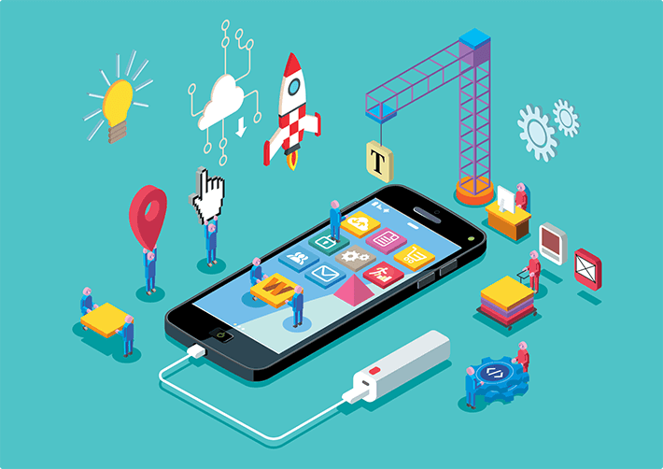
Design thinking in IT industry
Scenario based prototyping
Developing an app for IOS or Android and giving it to the customer for feedback
Revisions are must
Instead of giving the original app developed, photos (Photoshop, illustrator or any other app) with real scenarios (push button enabled or directing to the test case) may be done.
Now UI experts and User experience experts come to play and finally after many revisions the app is presented in its original form to the customer. (Even rolling out of Beta forms are in practice)
Types of Prototyping: Rapid prototyping/throwaway and Evolutionary prototyping

Slide 30
Design thinking in IT industry
Scenario based prototyping
Scenarios
Rich stories of interaction
Plain text, pictures, sketches, screenshots etc.,
Storyboards
Scenarios make us think about the design in detail and notice potential problems before they happen

Slide 31
Thank You

